Slide 1
Arte – Lcs Meeting 26.5.2021
Designed to serve you - made by Pascal Ulli
Mai 2021, Zürich

Slide 2
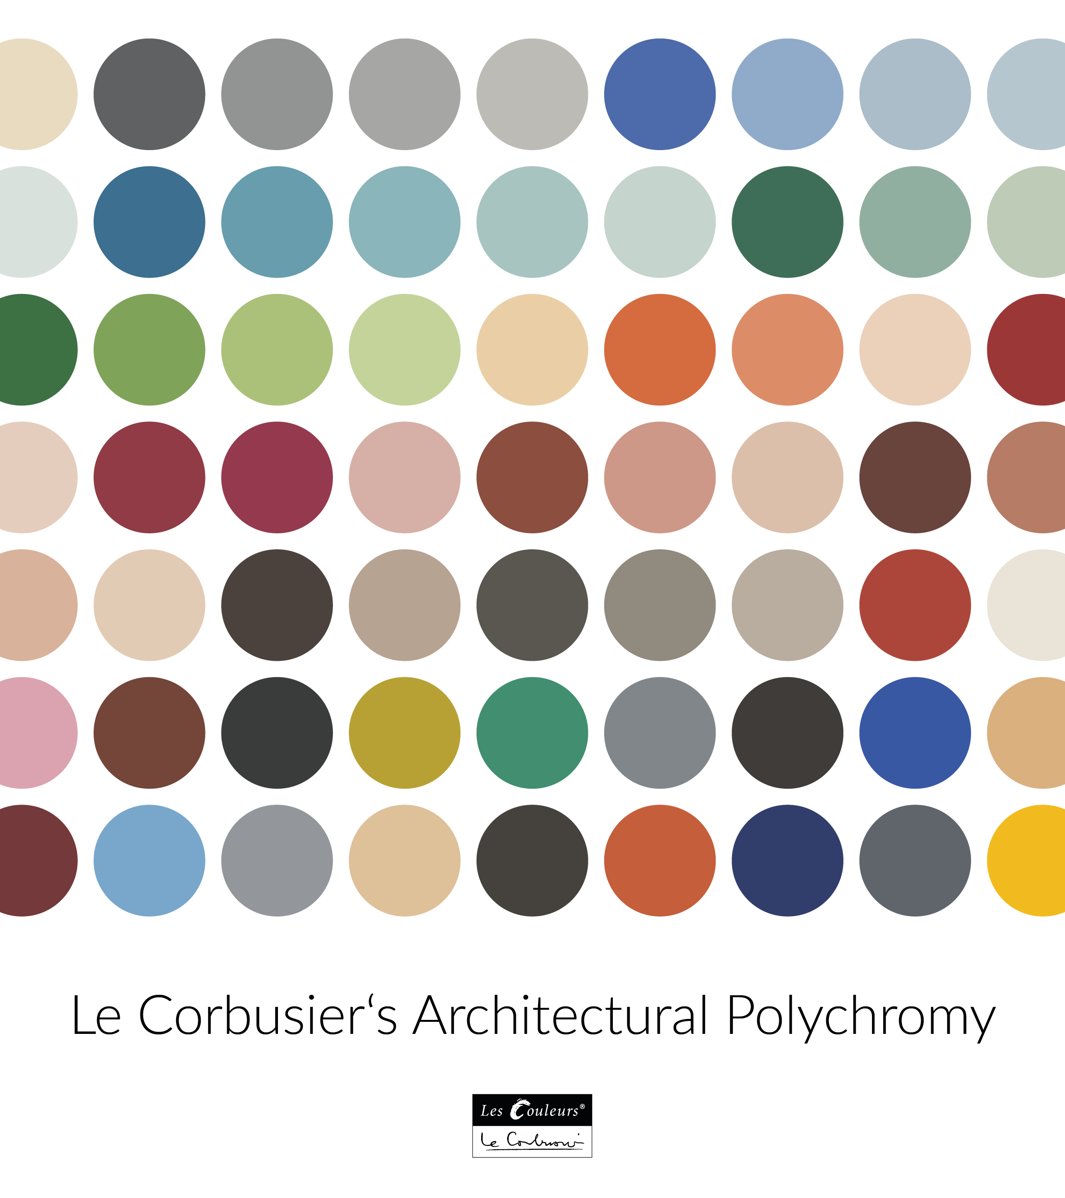
Farbe ist ein Auslöser starker Wikungen. Farbe ist ein Faktor unserer Existenz

Slide 3
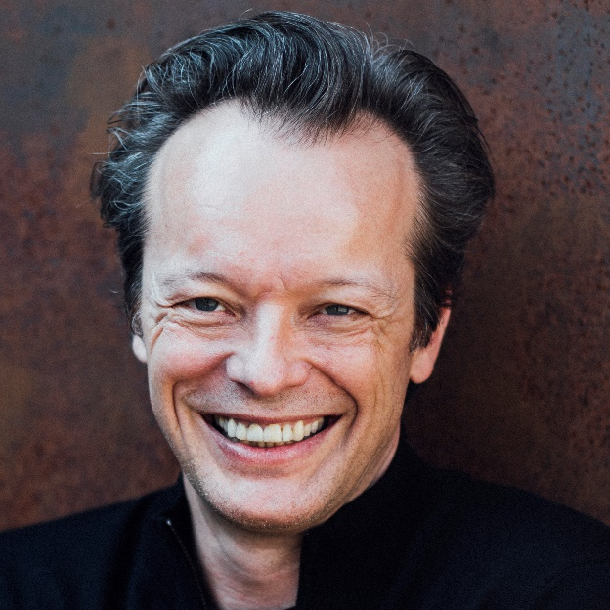
Who’s here today
Matthias Naumann
Vittorio Bastianelli
Chairman&Founding Partner
Key Account & Marketing

Slide 4
Tables of contents
  Brief review Partnership Arte/LCS
  What does LesCouleur®LeCorbusier
  Look into the future
  Ways to improve Partnership Arte/LCS
  Next Steps

Slide 5




Brief review Partnership Arte/LCS
Collections Arte/LCS
Figures 2017-2020
activities Arte/LCS
Oerlikon

Slide 6
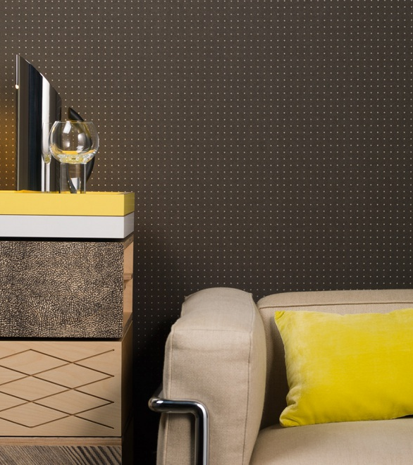
Collections Arte/LCS
  Dots (40 colors)
  Unity ( 8 colors)
  Stone ( 6 colors)
  Tints (13 colors)
  Pavilion ( 6 colors)
  Squares (2 colors)
With our colors you build a unique environment.

Slide 7
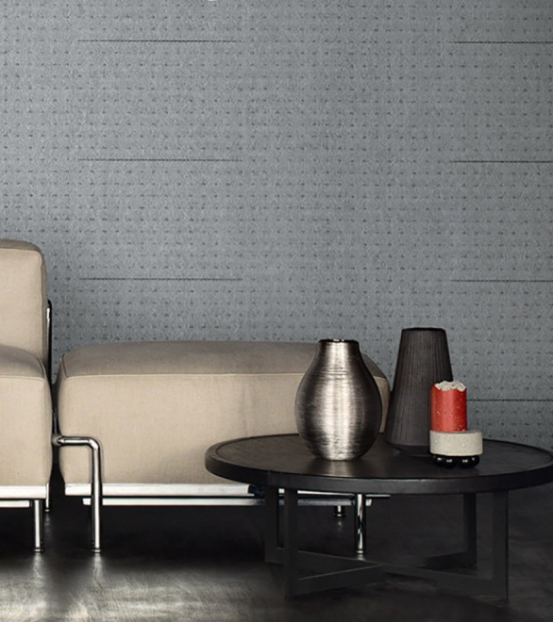
Collections Arte/LCS
  Dots (40 colors)
  Unity ( 8 colors)
  Stone ( 6 colors)
  Tints (13 colors)
  Pavilion ( 6 colors)
  Squares (2 colors)
With our colors you build a unique environment.

Slide 8
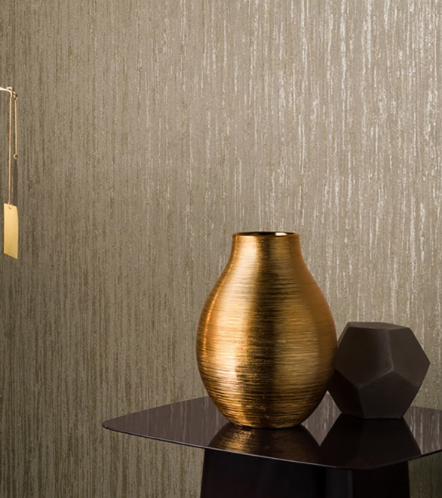
Collections Arte/LCS
  Dots (40 colors)
  Unity ( 8 colors)
  Stone ( 6 colors)
  Tints (13 colors)
  Pavilion ( 6 colors)
  Squares (2 colors)
With our colors you build a unique environment.

Slide 9

Collections Arte/LCS
  Dots (40 colors)
  Unity ( 8 colors)
  Stone ( 6 colors)
  Tints (13 colors)
  Pavilion ( 6 colors)
  Squares (2 colors)
With our colors you build a unique environment.

Slide 10
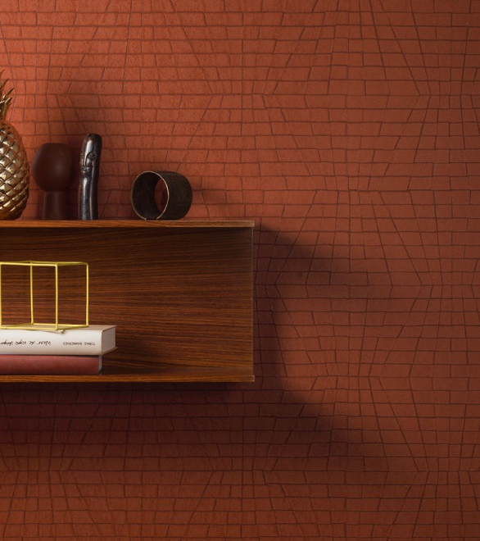
Collections Arte/LCS
  Dots (40 colors)
  Unity ( 8 colors)
  Stone ( 6 colors)
  Tints (13 colors)
  Pavilion ( 6 colors)
  Squares (2 colors)
With our colors you build a unique environment.

Slide 11
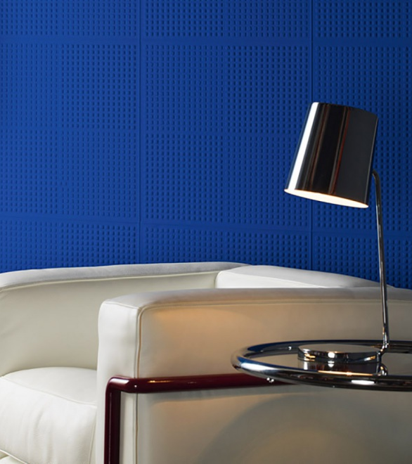
Collections Arte/LCS
  Dots (40 colors)
  Unity ( 8 colors)
  Stone ( 6 colors)
  Tints (13 colors)
  Pavilion ( 6 colors)
  Squares (2 colors)
With our colors you build a unique environment.

Slide 12
Brief review Partnership Arte/LCS
Collections Arte/LCS
Figures 2017-2020
activities Arte/LCS
Oerlikon

Slide 13
Chart slides with one highlight color (jaune vif)
(24, white)

Slide 14
Chart slides with one highlight color (jaune vif)
(24, white)

Slide 15
Brief review Partnership Arte/LCS
Collections Arte/LCS
Figures 2017-2020
activities Arte/LCS
Oerlikon

Slide 16
Activities 2020
Arte
Les Couleurs®LeCorbusier
Ambassador Speech at IMM Cologne
Vitra exhibition "Home Stories. 100 years, 20 visionary interiors" 2020
Sponsoring KABE colour panels by LCS, light switches by Jung
Publireporte in "20min Home & Garden" Mai 2020
Placement of LCS in the press
Jung Webinar «Color rush" April 2020
Integration of Polychromie Architecturale and the LCS network
Keim Newsletter and special Landing Page
Car Design Sculptur in Marseille with LC colours
Live Talks during Dezeen Virtual Design Week with Rado
1. Highlight in rouge vermillon 31 (footnotes, font size 14)
2. Highlight in jaune vif
Source: Les Couleurs

Slide 17
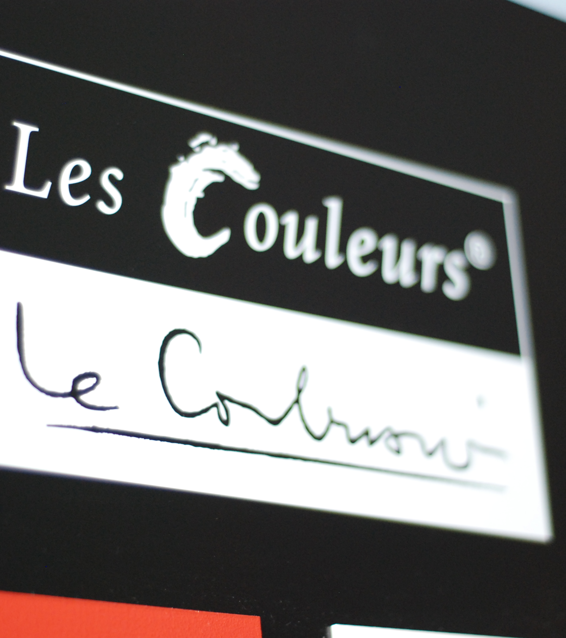
What does Les Couleurs®Le Corbusier

Slide 18
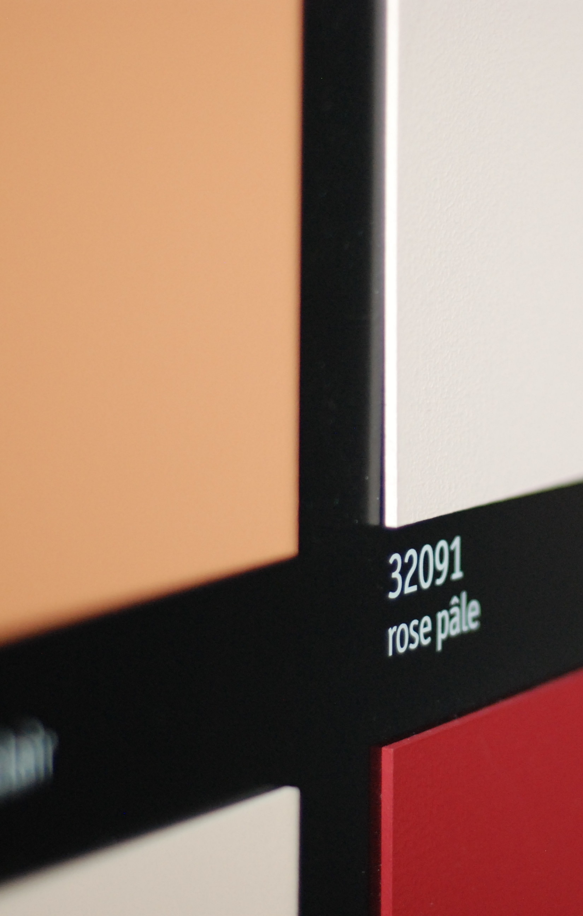
Polychromie Architectural
Marketing Material
Partner network

Slide 19

Polychromie Architectural
Guarantee of color consistency using the latest Technologies (Quality Lab)
Guarantee of color tones that remain identical over decades (testing and color approvals)
Unique colors of Polychromie Architectural are based on a variety of pigments (continuous exchange on new pigments/environmentally friendly)

Slide 20
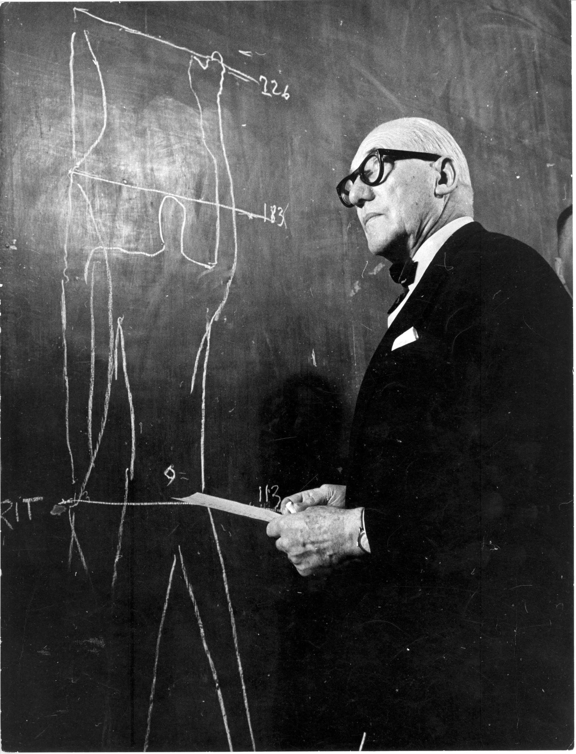
Marketing/Content
Ensure and actualize content and statements on
Polychromie Architecturale
Adequate use of image and next materials (approval by FLC)
LCS 24h Marketing Service: NextCloud - LC®LC Partner Login (Arte: Mr. Greet Lammens)
Les Couleurs®LeCorbusier Brand Manual

Slide 21
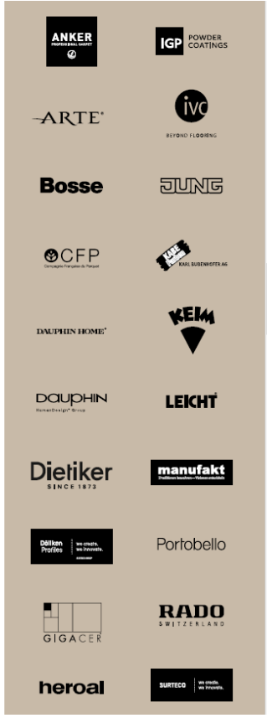
Marketing/Activities
Ensure presence and awareness among broad network of Architects, Interior Designers, Experts etc.)
- periodical Newsletter (>25000 contacts)
- LCS Ambassadors (seminars, )
- Social Media presence/push
- Partner network
- Joint Events (Jung, Heroal, Kabe, Gigacer etc.)
- Social Media presence/push
- Social Media presence/push

Slide 22
Expand Parnter Network
Partners active in areas connected in some way to LC®heritage (Architectural, Colors, Design, Art, Lifestyle)
Similar vision regarding Quality and Excellence (Premium Brands)
Complementary and internationally active

Slide 23
Tables of contents
  Brief review Partnership Arte/LCS
  What does LesCouleur®LeCorbusier
  Look into the future
  Ways to improve Partnership Arte/LCS
  Next Steps

Slide 24
  Look into the future
  Targets LesCouleurs®LeCorbusier
  Increase Brand awareness and penetration of the Polychromie Architecturale
  Increase partner network and intensify cooperation with existing partners
  Intensify cooperation with ambassadors and experts particularly in the USA

Slide 25
  Increase Brand awareness and penetration of the Polychromie Architecturale
  Content
  Videos; Image Video on LCS&The Polychromie Achrchitecturale
  Video Pod Casts: with Amabassadors/Experts
  Quotes: Increased leverage for Partners in news and content feeds
  LesCouleurs®LeCorbusier Book “Architectural Color Design” new only English Version for Partners, Experts, Ambassadors, Opinion Leaders (focus USA, UK, Australia)

Slide 26
  Increase Brand awareness and penetration of the Polychromie Architecturale
  Marketing Investments
  Strong Social Media Campaign
  (Twitter, Linkedin, Instagram, Facebook)
  Periodical Newsletter
  Cross Reference with our partners (Webpages, joint communications
  Quotes: Increased leverage for Partners in news and content feeds
  LesCouleurs®LeCorbusier Book “Architectural Color Design” new only English Version for Partners, Experts, Ambassadors, Opinion Leaders (focus USA, UK, Australia)

Slide 27
Tables of contents
  Brief review Partnership Arte/LCS
  What does LesCouleur®LeCorbusier
  Look into the future
  Ways to improve Partnership Arte/LCS
  Next Steps

Slide 28



Ways to improve Partnership Arte/LCS
.
Intensify our cooperation
Ambition
Pro-Longation Liscense Agreement
Launch new collections
Enter/Develop new geographical markets
Business
Share more Marketing-Information
Intensify Arte/LCS content on Webpage and Social Media (content: Quotes, references, Video, Projects…..
Partners

Slide 29




Profit from LCS continuous effort maintaining quality and standard of PA colors
Why
Why
Profit from LCS support (Brand Manual/NextCloud with images and texts
Profit from LCS marketing investments and exposure
Profit from LCS awareness and interest increase thanks to modern and professionally targeted contents on LC and PA colors
Profit from LCS partner network coherent and in line with in vision and values

Slide 30
Tables of contents
  Brief review Partnership Arte/LCS
  What does LesCouleur®LeCorbusier
  Look into the future
  Ways to improve Partnership Arte/LCS
  Next Steps

